Slide 1
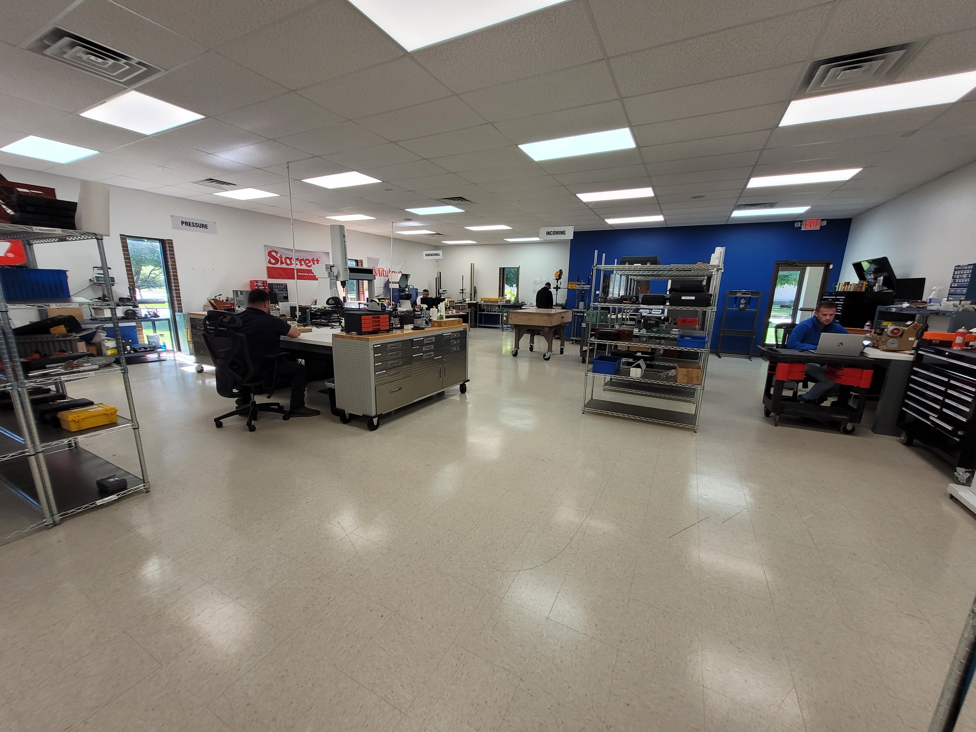


Slide 2
Who is TMI?
TMI Operates 13 full service Calibration Labs across the United States and many OTS sites.
Accredited by A2LA to ISO17025 with a broad scope of capabilities
OTS Program; we’ll setup and manage your entire calibration and asset management program for you at your site
Lab Services; we’ll pick-up and deliver your equipment in a timely manner
Temporary On-Site Service; we’ll bring our technicians and standards to your facility
Any combination of the above or something new; just tell us your needs. We’ll customize solutions to your unique requirements.

Slide 3
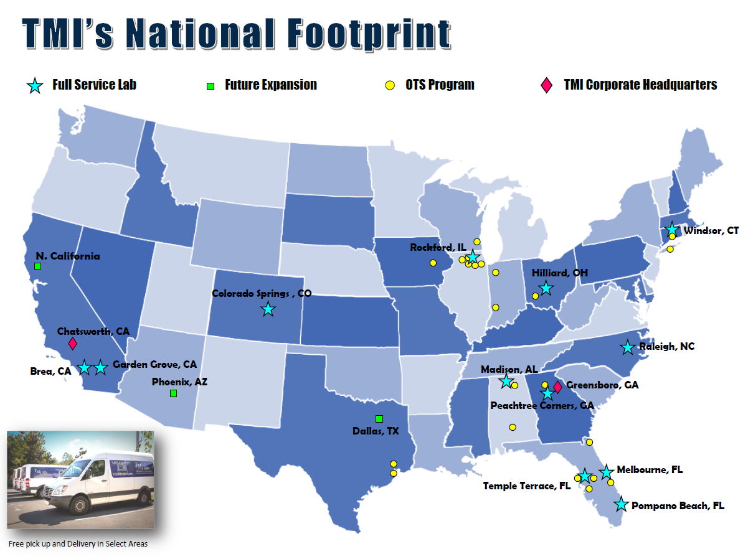

Slide 4
ISO 17025 CERTIFICATION
TMI Labs are Certified by A2LA for ISO 17025. This certification is the core by which our Quality Manual and Procedures are built on.
Through the A2LA Certification TMI is able to provide calibrations to: ANSI/Z540-1, ANSI/Z540.3 and ISO/IEC 17025 with Measurement Uncertainties
The ISO 17025 Certification also satisfy the requirements called out for ISO 9001:2008.
Through our ISO 17025 Certification, TMI is also compliant with Nuclear requirements 10CFR50 and 10CFR21.
The ISO 17025 Certification is also in compliance with AS 9100 requirements and TMI will implement specific process changes as required for each location.

Slide 5
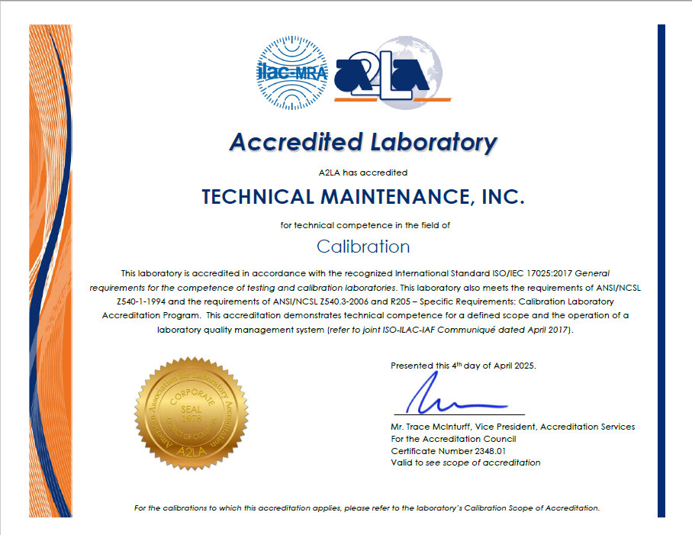

Slide 6

Services We Offer
OTS Program
Laboratory Services
Temporary On-Site Services
TMI can setup and maintain your entire calibration program for your company at your business site.
TMI can pick-up, service and deliver your equipment in a timely manner.
TMI will bring our technicians and company standards to your business.
First Article Inspections
Tool Repair Services
Cleanroom Certifications
TMI can do First Article Inspections using our Mitutoyo CMM
TMI can supply your business with full time personnel to provide repair services to your tools and/or test instruments.
Clean Room, Fume Hood, and Safety Cabinet. TMI tests in accordance with ISO 14644 and IEST-RP-CC-006.3 parameters.
Field Service Management
Customizable Solutions
TMI can manage all assets for your filed service techs, eliminating down time and streamlining the calibration process.
TMI can offer customizable solutions to fit your business needs. Choose any combination of the above solutions to tailor a program specifically to meet your requirements.

Slide 7

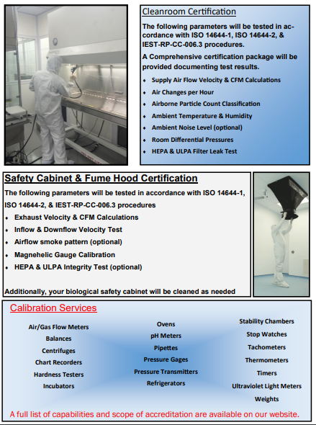
CLEAN ROOM CERTIFICATION

Slide 8
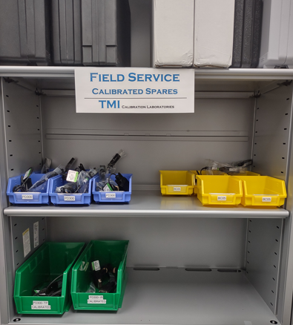
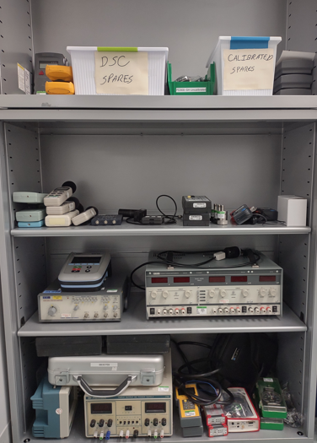
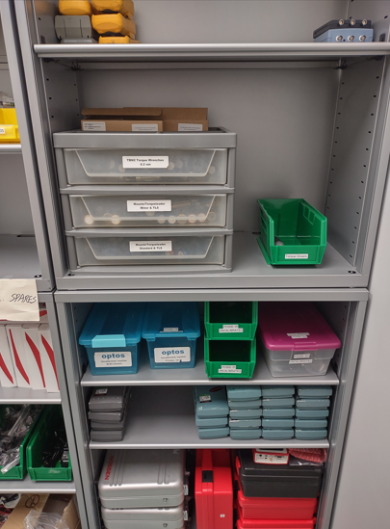
Field Service Management
TMI will store, manage, calibrate and ship your assets directly to your filed service technicians.
TMI will send recall notices to field techs notifying them of what is due, send a calibrated asset and a shipping label to return assets due for calibration.
This type of program can reduce downtime of your field service technicians waiting for their calibrated assets to be returned to almost zero.

Slide 9
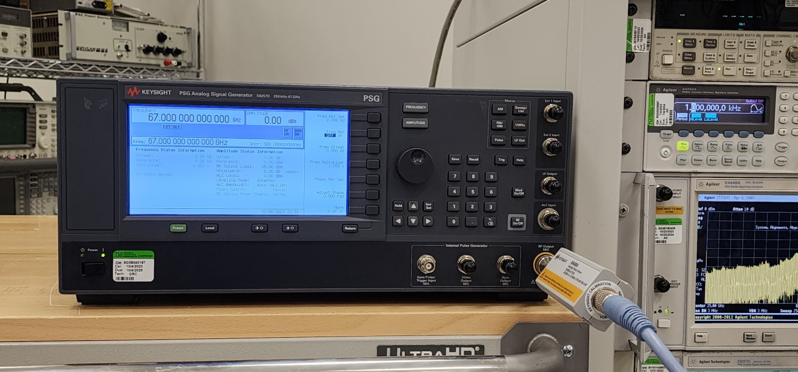
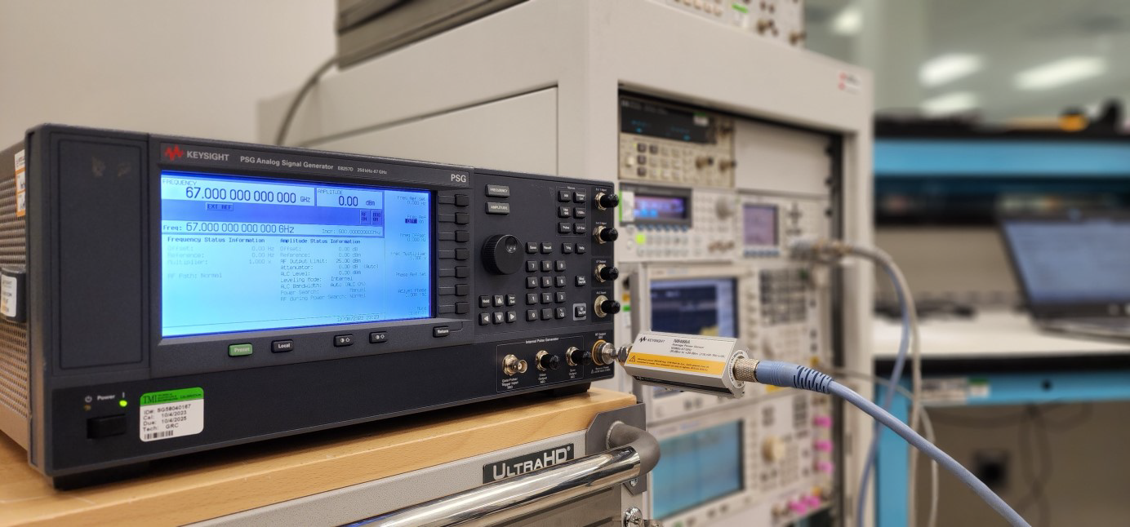
In an ever changing world of technological advancement, TMI is prepared to meet the needs and challenges of various industries. We are dedicated to investing in the standards and equipment necessary to support the unique and diverse equipment developed and utilized by our many new and existing customers.
With the purchase of equipment such as our
E8257D-567, Signal Generator and N8488A, Power Sensor shown here. TMI has invested in order to support your needs!
This expansion to our RF calibration range allows us to support the following equipment up to 67 GHz:
Spectrum Analyzers
Signal Generators
Oscilloscopes
Network Analyzers

Slide 10
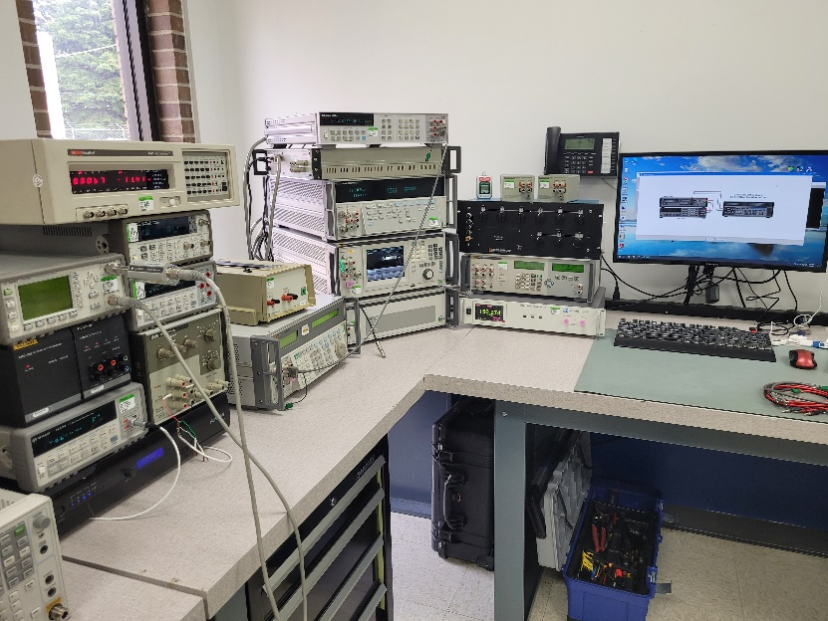
TMI’s levels of certifications:
Basic Calibration (Z540-1)
  A NIST traceable Certificate of Calibration stating that the item either passed or failed calibration with OOT Data
Data Calibration (Z540-1)
  Same as above but includes As Found/Left data for analysis
ISO/IEC 17025 Calibration
  This is the highest level of calibration and includes the information above combined with statements of uncertainty for each measurement
Calibrations with Guard Banding (ANSI/Z540.3)
  Same as above with False Acceptance Determinations as necessary based on TUR

Slide 11
TYPICAL LEAD TIMES
The target acceptable On Time Delivery (OTD) for all service deliveries is 95%. Measurement duration begins upon receipt of equipment by TMI and ends when the equipment is returned to the customer.
DeliveryMethod Location of Service Turn-Around-Time
OTS On-Site Calibrations Prior to due date
TMI Lab Local TMI Lab Typically 5 working days
TMI Network Lab TMI Network Lab Typically 10 working days
Vendor Cals 3rd Party or MFG Target is 25 days

Slide 12
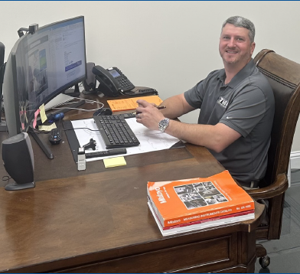
New Equipment Sales
Through our partnerships and our direct distributor programs, TMI has become a top tier distributor for your new equipment needs; from hand held tools to capital equipment including CMM’s
• Added Savings from Reduced Calibration Costs
• Shorter Delivery Schedules…you get it quicker…less down time
• Electronic Calibration Certificates and Data
• TMI is your single source to Buy, Calibrate and Track your assets
Brian Floyd
New Equipment Sales Mgr.
neworders@tmicalibration.com
727-698-9484

Slide 13
On-Site Technical Services (OTS Sites)
Complete Life Cycle Management of inventory
Asset Tracking
Calibration Recall Program
Customized Calibration and Repair Service
Audit Support

Slide 14
Complete Life Cycle Management
Assistance with the acquisition of new equipment
Calibration and repair during useful life
End of Life disposition of equipment
  Trade
  Sell
  Scrap
  Replace

Slide 15
Asset Tracking
Historical Activity
Inventory Status Reports
Calibration & Repair Documentation
Out of Tolerance Notification
Calibration Interval Adjustments
  TMI will work with the customer to monitor and adjust calibration intervals, when necessary

Slide 16
Calibration Recall Program
Calibration Due notices will be sent out to each department
Overdue Calibration notices will be sent to each department
Out of Tolerance notices will be sent to the Department Manager and/or Quality Manager for evaluation immediately when the condition is found

Slide 17
Calibration/Repair Services
TMI will provide monthly calibrations on-site
TMI will process and expedite items that need to be calibrated by one of our network labs
TMI will process, monitor and expedite any items that need to be sent to OEMs for calibration or repair.
TMI will enter Cal Certs and Data Sheets into the IndySoft Asset Management database.

Slide 18
Audit Support
Support with customer internal audits
  We need 24 hours notice
Support with customer external audits
  We need 24 hours notice
TMI audits of calibration program
  Our Quality Manager will audit this location to make sure it continues to meet our corporate quality standards

Slide 19
QUALITY
Sample Reports

Slide 20
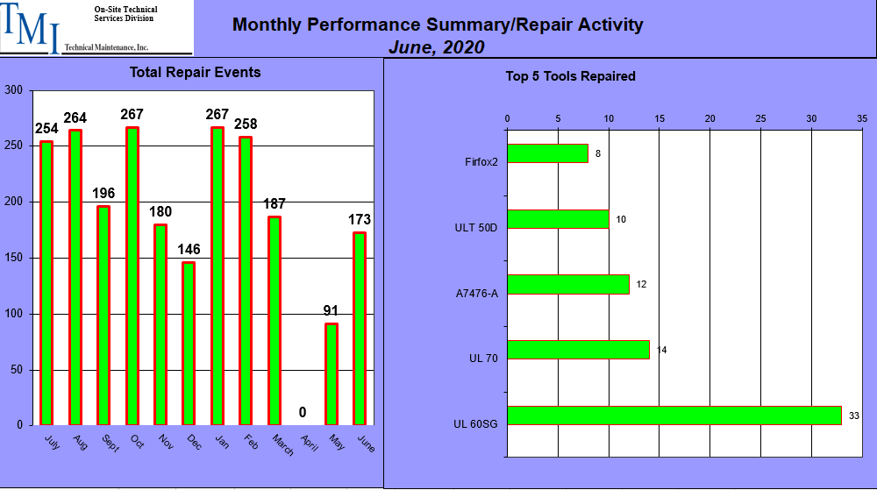
Performance Metrics
Total Calibrated
Out of Tolerance
Adjusted
ROV
Rejected

Slide 21
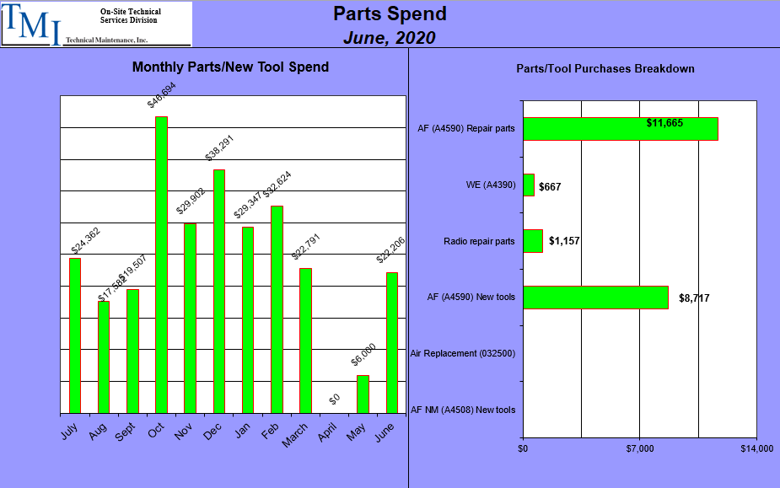

Slide 22
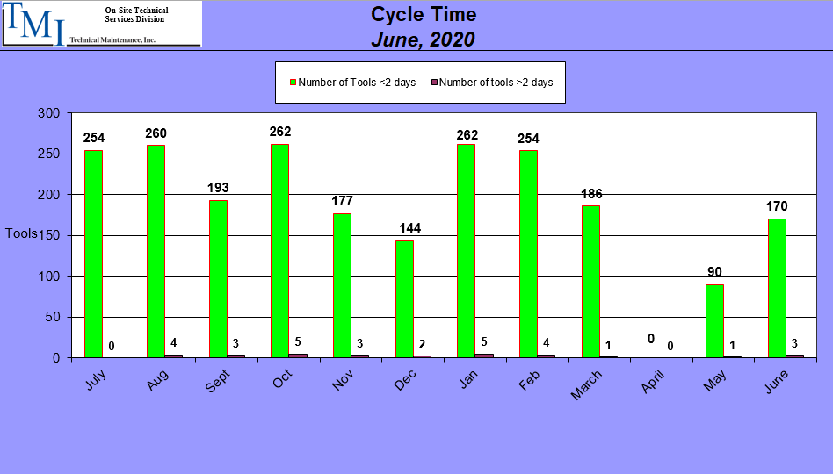

Slide 23
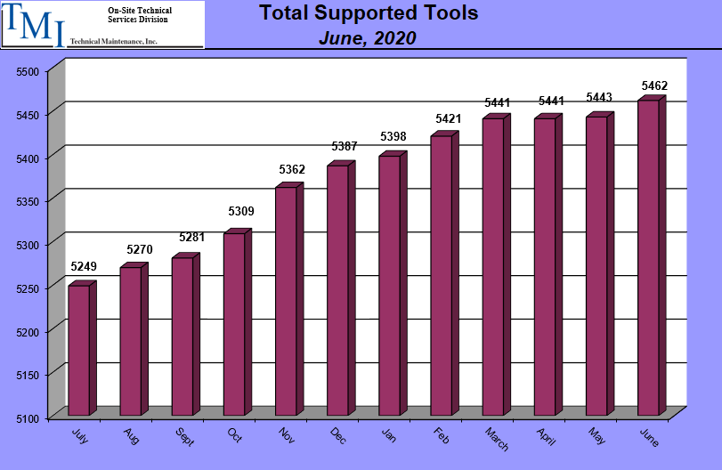

Slide 24
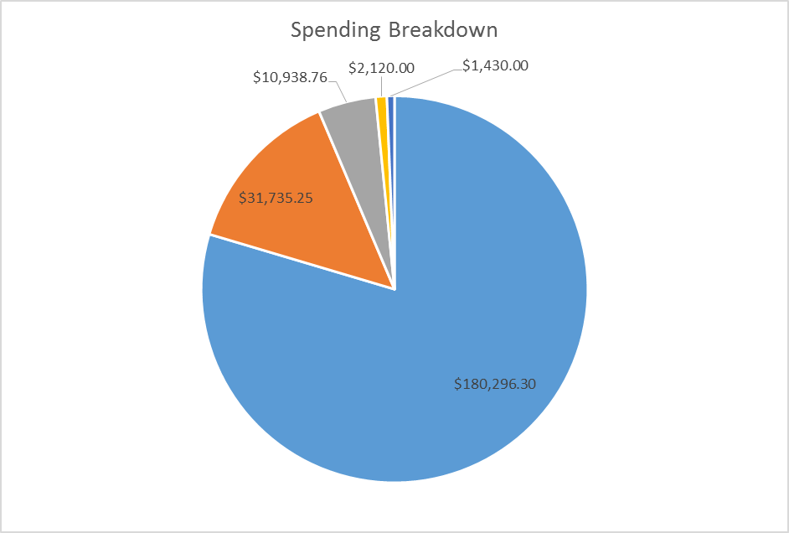
Spending Breakdown
Year to Date

Slide 25
CORRECTIVE ACTION REPORTS (CARS)
Description of the Non Conformance
Root Cause Analysis
Containment
  To contain the current Non Conformance
Corrective Actions
  To eliminate future reoccurrences
Target Date to implement Corrective Actions

Slide 26
IMPROVEMENT PLANS
TMI is always looking for ways to improve our processes and reduce costs.
When justified, TMI will add capabilities to minimize the need for using the OEMs and other specialty service providers. TMI’s cost is typically 25-35% less expensive so this will be a cost savings to our customers.
Automation will be added when possible to improve the turnaround times which will minimize downtime for our customers.

Slide 27
WHY TMI?
EXPERIENCE
DEDICATED TO CUSTOMER SUCCESS
CUSTOMIZED SOLUTIONS
SCALABLE PROGRAMS
NIMBLE

